Slide 1
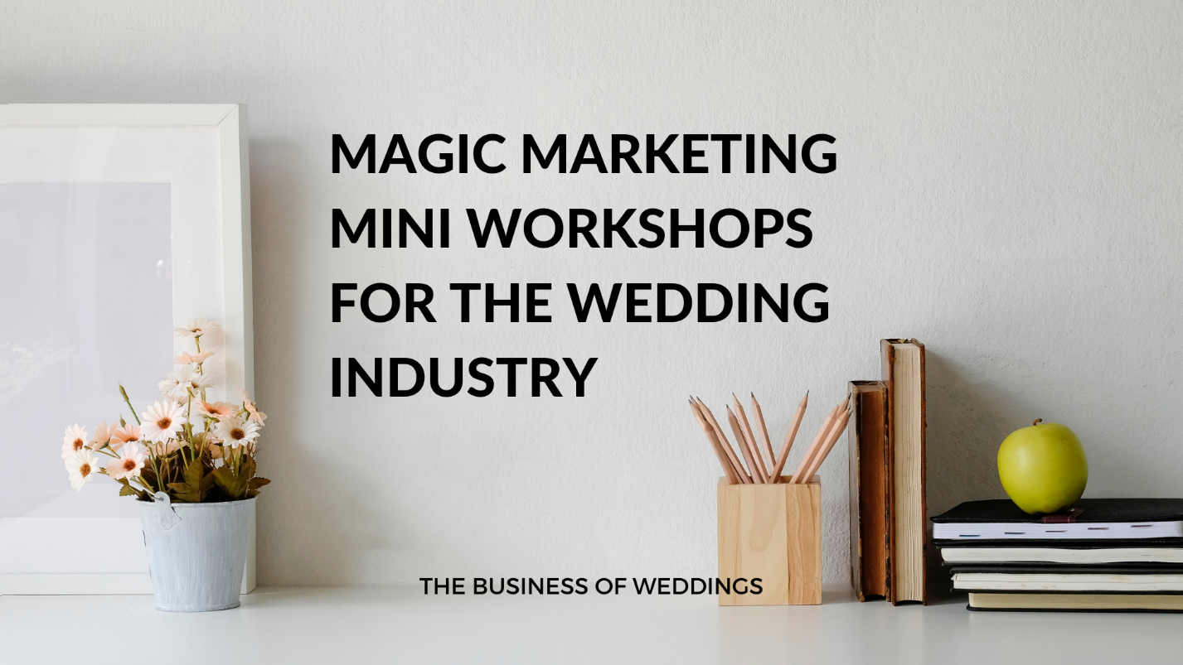
The magic Marketing MINI Workshop Day one
THE BUSINESS OF WEDDINGS
Notes:
NOTE:
To change the image on this slide, select the picture and delete it. Then click the Pictures icon in the placeholder to insert your own image.

Slide 2
The strategies you will be creating to take your business online
Setting up a Facebook page and a Facebook group linked to it.
01
Setting up a free email system with Mailerlite.
02
Creating Graphics on Canva for your Facebook.
03
Creating a lead magnet to get subscribers onto your email list.
04
Linking it all up together and learning the strategies to grow an online audience.
05

Slide 3
Step Number One Creating a Facebook Page and Group
The first process of this strategy is to create a place where you are going to drive your audience. If you have a Facebook Page then you can also create a Facebook Group and link this to your page.
If you are planning to do something completely different then you need to create first a Facebook Page and link a group to it.
The difference between a page and group is that your page is public, anyone can find it on Facebook.
Your group is private, people can still find it if you have your settings to public but they cannot see what goes on in there unless they join it.
Your audience will feel much more comfortable in your group if they have a question as they know the only people that can see it are others within your group, it doesn’t show up on their profile or on a public Facebook page.

Slide 4
When you are in Facebook have a look at the top menu and you will see a button saying create. This will allow you to create a group or a page
Most of you will have a business page so you can create a group and link it to your business page.
If you wish to start something new then start with your Facebook Page and then add a group to it.
If you get stuck with this I am in this Facebook group to help you.
Next you need to create a header banner for your group.
It is best if you create this on Canva.
Log into Canva and select Facebook Cover.
If you are on pro then the size you need it to be is 2050 x 780 to fit a Facebook Header correctly, if you are on Canva pro you have the option to do this.
If you look at my headers within my groups, I have a Facebook Page Header, a Facebook Group Header and a Facebook Membership Club Header. They are all the same but just different text.
Do think carefully about what you are going to be calling your group as once you have over 500 members you cannot change the name of it.

Slide 5
I am here to get you from A to B so if you are getting stuck do just shout out.
I can use my Canva, etc to resize images for you if you need help.
You will then need to add a group description telling your audience what your group is about.
Have a look and add in as much as you can.
Later in this workshop I will show you a few tips as well to help you grow your Facebook group but at the moment we are just setting everything up.
I am also going to put into the group a Mailerlite tutorial from the Business of Weddings Membership Club so do have a read and start to understand this as we work on Day Two of the Workshop.
What I would also like you to do is start to think of a Lead Magnet.
A Lead Magnet is an offer or a freebie you are going to create to get your audience to sign up to your email list.

